Slide 1


Teacher of the Year Award
Name:Khaloud Alkhaled
Email: khalkhaled@gmail.com
Data Science Camp

Slide 2
Objective:
Main Target.
Visualization with python code explaining
The Result.
My point of view.
Conclusion.

Slide 3
Main Target:
“Teacher of the year award”
This reward based on the students interaction during the class in the three impotent subjects in the school base on the number of students in each subject classes in the Educational Stages.
So, I explore the school data to figure out the students and teachers interactions in classes, which will help us to identified the teachers who will be rewarded.

Slide 4
Exploring Data Analysis:
The data that I used contain 480 students.
The data is clean .

Slide 5
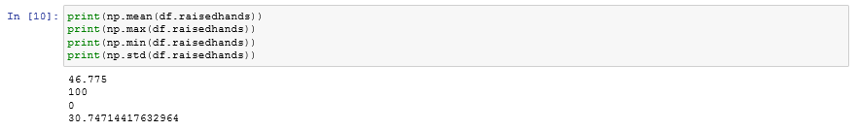
Exploring Data Analysis:
The output showing us that the minimum is zero of raising hands out of 480 students

Slide 6
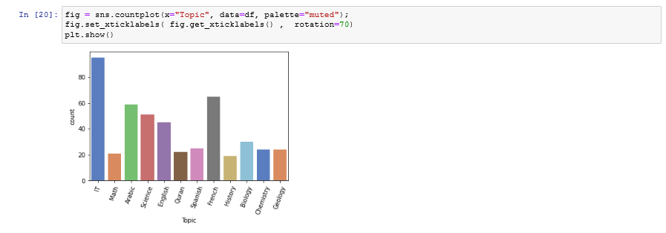
Handling outlier:
I start to handle the outlier by figure out the subjects which has the max of the students, the chart showing that IT, Arabic , and French has the max of the students

Slide 7
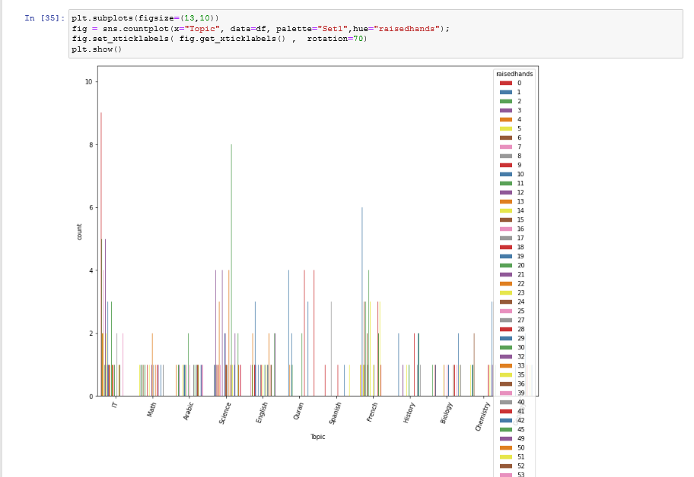
Information about the most interactive class in the school:
This chart showing us the raise hands in each subject for all the classes and even the countitiy .
Moreover, this chart showing us that the IT is the one.

Slide 8
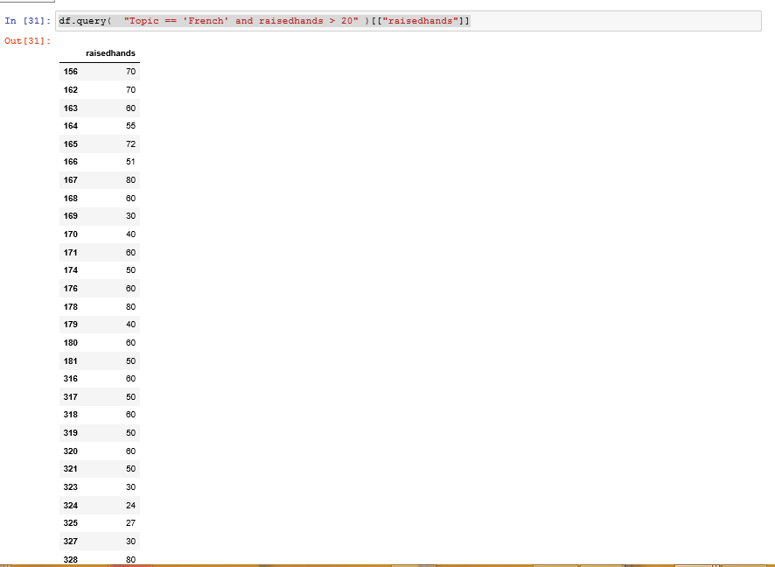
Information about the most interactive class in the school:
However, the school printable mentions that the comparative should be the counties also.
Which means over 20 times.
So, I do the comparative to find out the winner teacher.
The French subject comes with 31 outputs.

Slide 9
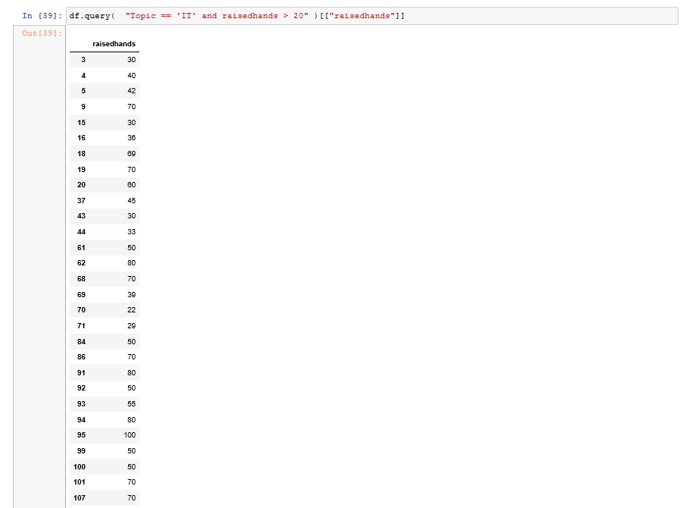
Information about the most interactive class in the school:
The IT subject comes with 39 outputs.

Slide 10
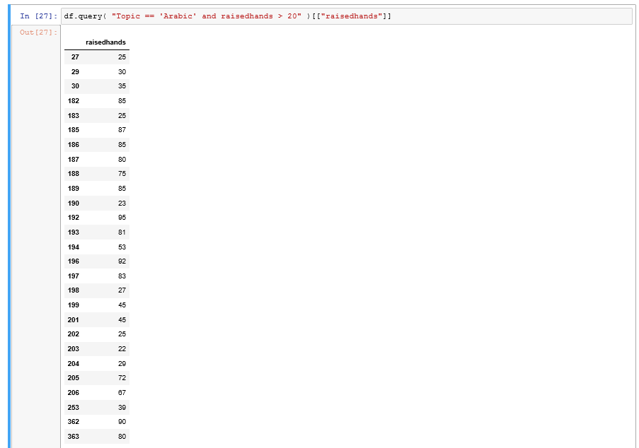
Information about the most interactive class in the school:
The Arabic subject comes with 27 outputs.

Slide 11
My point of view:
I think the way that the school followed to select the good teacher was not rational because the interaction is not the only way to use to identify who is the good teacher, but there are many aspects that could be used like students Grade/Mark.

Slide 12

Conclusion:
In conclusion, based on the data analysis that we have shown , the reward will go to IT teachers.

